Slide 1

Relational Health: Exploring the Link Between Interpersonal Relationships and Wellness
Renee Garbe, PhD, LMSW

Slide 2
Purpose of Today’s Workshop
Understand how our connections with others influence mental, emotional, and physical health
Explore the role of healthy relationships in resilience and overall well-being
Reflect on our own relationship patterns and their impact on self-care and stress with a focus on boundaries
Learn strategies to strengthen supportive connections

Slide 3
Ground Rules
Confidentiality
Respectful Listening
Optional Participation
Non-Judgment
What’s shared here, stays here
Let others finish, avoid interruptions, honor all voices
Share only if you feel comfortable; it’s okay to simply listen
We all come with different experiences; approach with openness

Slide 4
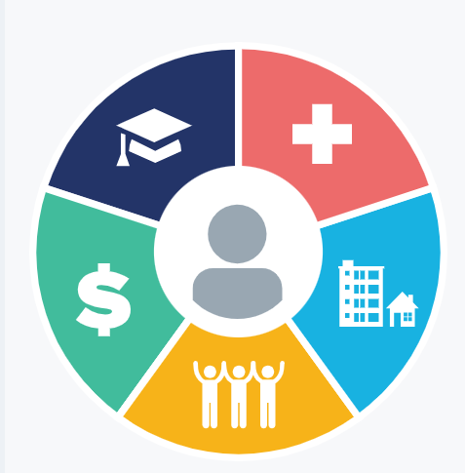
The Connection Between Relationships & Health
Relationships are a core social determinant of health
Quality of our connections affects how we think, feel, and function
Both supportive and unhealthy relationships play a role in long-term wellness

Slide 5
What the Research Shows
(Andersen et al., 2021; Grevenstein et al., 2019 Thomas et al., 2017)
Strong, positive relationships are linked to:
Lower stress and better coping skills
Reduced risk of anxiety and depression
Improved physical health (heart health, immune system, longevity)
Social isolation and poor-quality relationships increase risks for:
Chronic stress and burnout
Physical illness and premature mortality

Slide 6
Supportive Relationships & Wellness
(Andersen et al., 2021; Grevenstein et al., 2019 Thomas et al., 2017)
Provide emotional support and encouragement
Help regulate stress through belonging and connection
Contribute to healthy habits (exercise, nutrition, sleep)
Act as a protective factor during life transitions or crises

Slide 7
Risks of Unhealthy Relationships
(Andersen et al., 2021; Grevenstein et al., 2019 Thomas et al., 2017)
Can contribute to stress, anxiety, and depression
May limit access to social support and resources
Long-term exposure can harm physical health (blood pressure, immune function)
Some unhealthy dynamics can escalate to abuse (e.g., intimate partner violence)

Slide 8
Recognizing Unhealthy Dynamics loveisrespect.org
Constant criticism or put-downs
Lack of respect for your time, needs, or feelings
Control over choices, finances, or social connections
Unpredictable anger, manipulation, or guilt-tripping
Feeling unsafe, drained, or “on edge” in the relationship

Slide 9
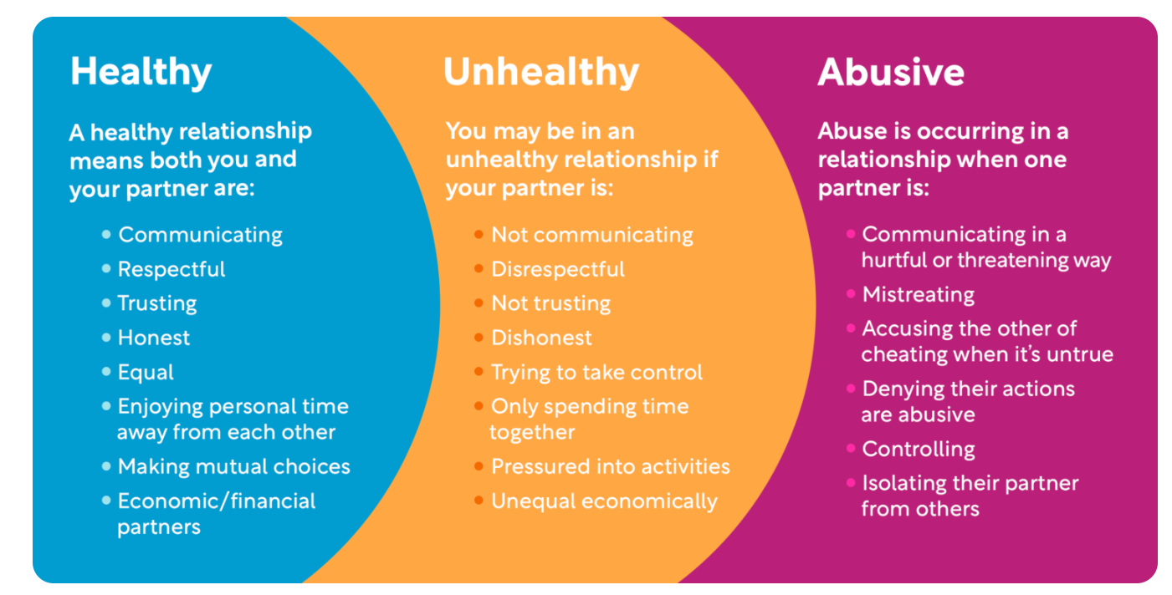
Loveisrespect.org

Slide 10
Boundaries as Self-Care
(Chernata, 2024; Tawwab, 2021)
Boundaries help protect your well-being and define healthy connection.
Emotional Boundaries
Physical Boundaries
Digital Boundaries
Protect your feelings, values, and energy
Respect personal space, privacy, and safety
Manage how, when, and with whom you connect online

Slide 11
Boundary Check-In
I say “yes” to a person when I want to say “no”.
Yes, I do that often.
I say “no” and I tell people why I’m saying “no” so that they don’t ask me anymore.
I usually say “no” without apologizing or lying about it.

Slide 12
Boundary Check-In
I feel like I’m constantly having to save people close to me and fix their problems all the time.
No, I don’t get involved with other people’s issues.
Yes, often.
No. I know my limitations and offer what I can, when I can.

Slide 13
Boundary Check In
I find myself sucked into pointless fighting or debating regularly.
Yes.
No, I don’t experience that.
No. I try to keep people at a distance.

Slide 14
Boundary Check In
I feel guilty when I say 'no' to someone
Yes
No
No, I don’t care what people think. I’m annoyed/angry/frustrated when people ask me for things.

Slide 15
Boundary Check In
I am able to hear 'no' from people and not take it personally.
Yes.
No, I take it personally.
I don’t usually ask people for help. I don’t think they’ll do it right, or I can’t trust them.

Slide 16
Boundary Check-In
I feel guilty for dedicating time to myself.
Yes.
No. I know that I need to take care of myself in order to take care of others.
No. I prioritize my own needs over anyone else’s.

Slide 17
Boundary Check In
I apologize for things when they're not my fault.
Yes.
No. I apologize when I’ve done something that I am responsible for, and I know I’ve hurt someone.
No, things aren’t typically my fault.

Slide 18
Boundaries Handout
(Tawwab, 2021)
No.
No, thanks.
I think I'll pass.
I'm not taking on new things.
It doesn't sound like the right fit.
I'd rather not, thanks.
That doesn't work for me.
I appreciate your time, but no thank you.

Slide 19
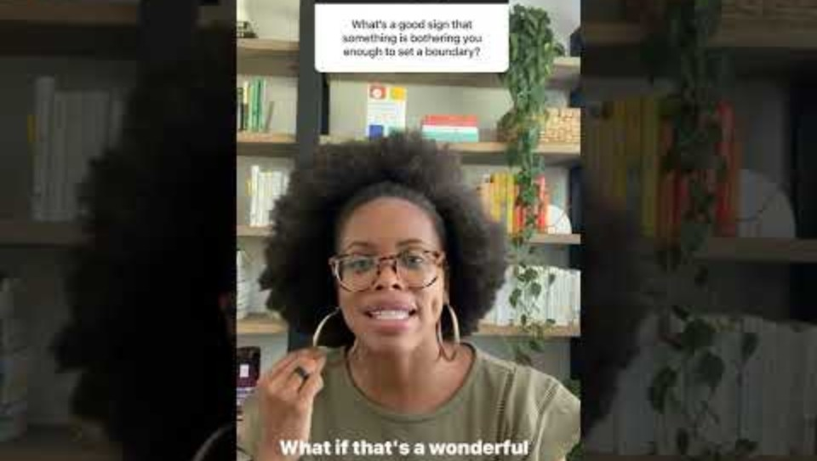
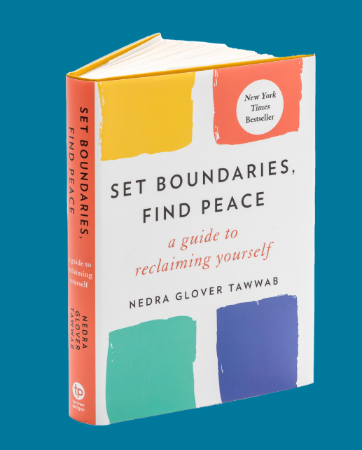
Boundaries Expert: Nedra Glover Tawwab, LCSW
Notes:
When to set boundaries? When do we know we need to set them?

Slide 20
Strategies to Promote Healthy Relationships
(Murray et al., 2021)
Communication Skills
Active Listening: Pay attention, reflect back, validate feelings
“I” Statements: Share your perspective without blame (e.g., “I feel… when…”)
Expressing Needs Clearly: Be direct, specific, and respectful
Conflict Resolution
Focus on the issue, not the person
Practice calm problem-solving rather than escalation
Seek common ground and compromise where possible
Take breaks if emotions run too high

Slide 21
Building Supportive Networks
(Murray et al., 2021; Tawwab, 2021)
Surround yourself with uplifting, trustworthy people
Cultivate mutual support: give and receive care
Reach out when you need help:
Community & peer supports
Counseling services
Hotlines and resources for relationship concerns or IPV

Slide 22
TL/DR
Relationships are powerful determinants of health
Supportive connections can reduce stress, build resilience, and improve wellness
Recognizing unhealthy dynamics & setting boundaries are forms of self-care
Healthy relationships thrive on communication, respect, and mutual support
Resources and supportive networks are available

Slide 23
Resources
National Domestic Violence Hotline (24/7)
1-800-799-SAFE (7233)
Crisis Text Line
Text HOME to 741741
Mental Health Support
Counseling & Wellness Center Campus Location: A1120
Phone:708.235.7334
Community Resources:
Anew: Building Beyond Violence and Abuse
Hours: Mon – Fri 9 a.m. - 4 p.m.
Phone: (708) 794-2140
Web: https://anewdv.org
Population Served: Men and Women
www.govst.edu/gsu4u-domestic-violence-resources/

Slide 24
Resources
Andersen, L. M. B., Rasmussen, A. N., Reavley, N. J., Bøggild, H., & Overgaard, C. (2021). The social route to mental health: a systematic review and synthesis of theories linking social relationships to mental health to inform interventions. SSM-Mental Health, 1, 100042.
Grevenstein, D., Bluemke, M., Schweitzer, J., & Aguilar-Raab, C. (2019). Better family relationships––higher well-being: The connection between relationship quality and health related resources. Mental Health & Prevention, 14, 200160.
Chernata, T. (2024). Personal boundaries: definition, role, and impact on mental health. Personality and Environmental Issues, 3(1), 24-30.
Murray, C. E., Ross, R., & Cannon, J. (2021). The happy, healthy, safe relationships continuum: Conceptualizing a spectrum of relationship quality to guide community-based healthy relationship promotion programming. The Family Journal, 29(1), 50-59.
Tawwab, N. G. (2021). Set boundaries, find peace: A guide to reclaiming yourself. Penguin.
Thomas, P. A., Liu, H., & Umberson, D. (2017). Family relationships and well-being. Innovation in Aging, 1(3), igx025.

