Slide 1

HoNORS SEMINAR IN ROME
May 20-June 17, 2017

Slide 2
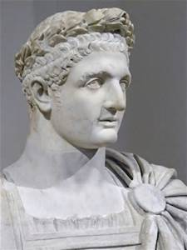
Class HONS 4900
Leadership in Italy
  With a total of four weeks, three weeks will be dedicated to ancient Rome, Florence and Venice – connected back to modern theoretical perspectives on leadership. One week will be dedicated to modern European Leadership styles.
  The ancient weeks will incorporate field trip tours.
  The modern week will incorporate internship/service days.

Slide 3
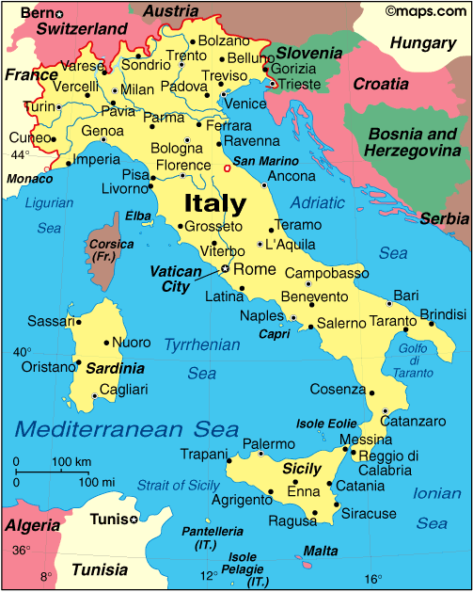
italy

Slide 4
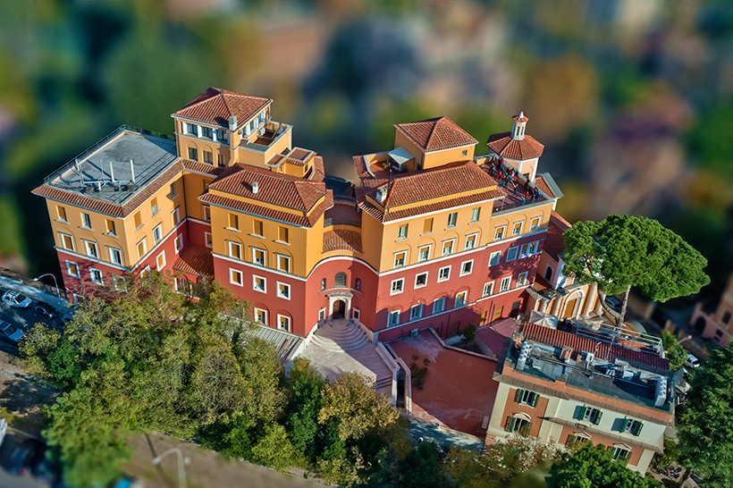
The American university of rome
The AUR campus is housed within an ancient Barnabite monastery atop the Janiculum, Rome’s highest hill

Slide 5
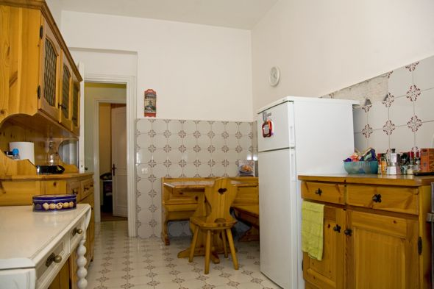
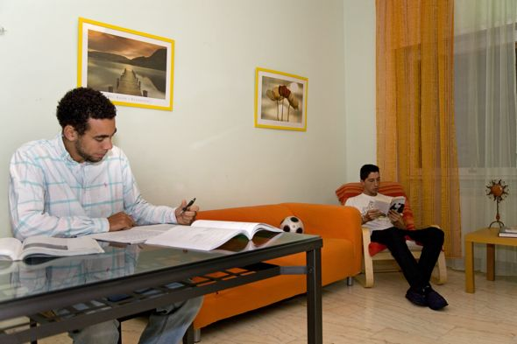
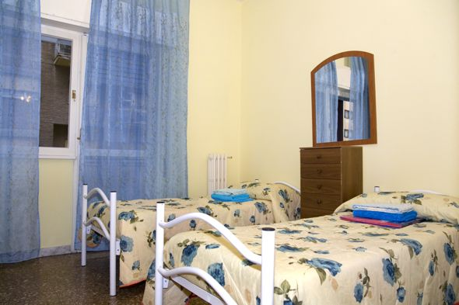
Italian apartments
Students will be housed in Italian apartments near the university
Apartments will be all male or female, complete with full kitchens and bathrooms

Slide 6
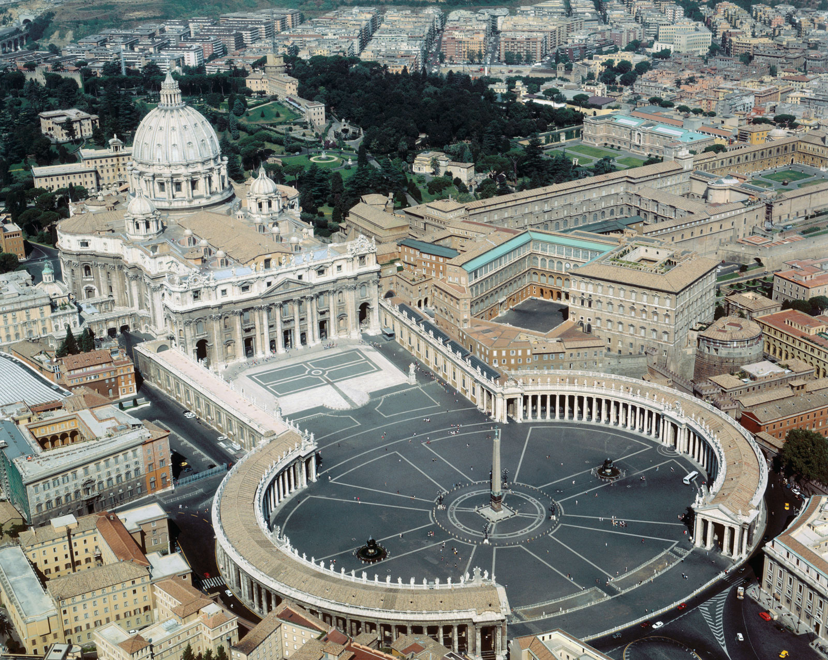
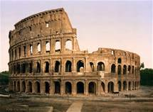
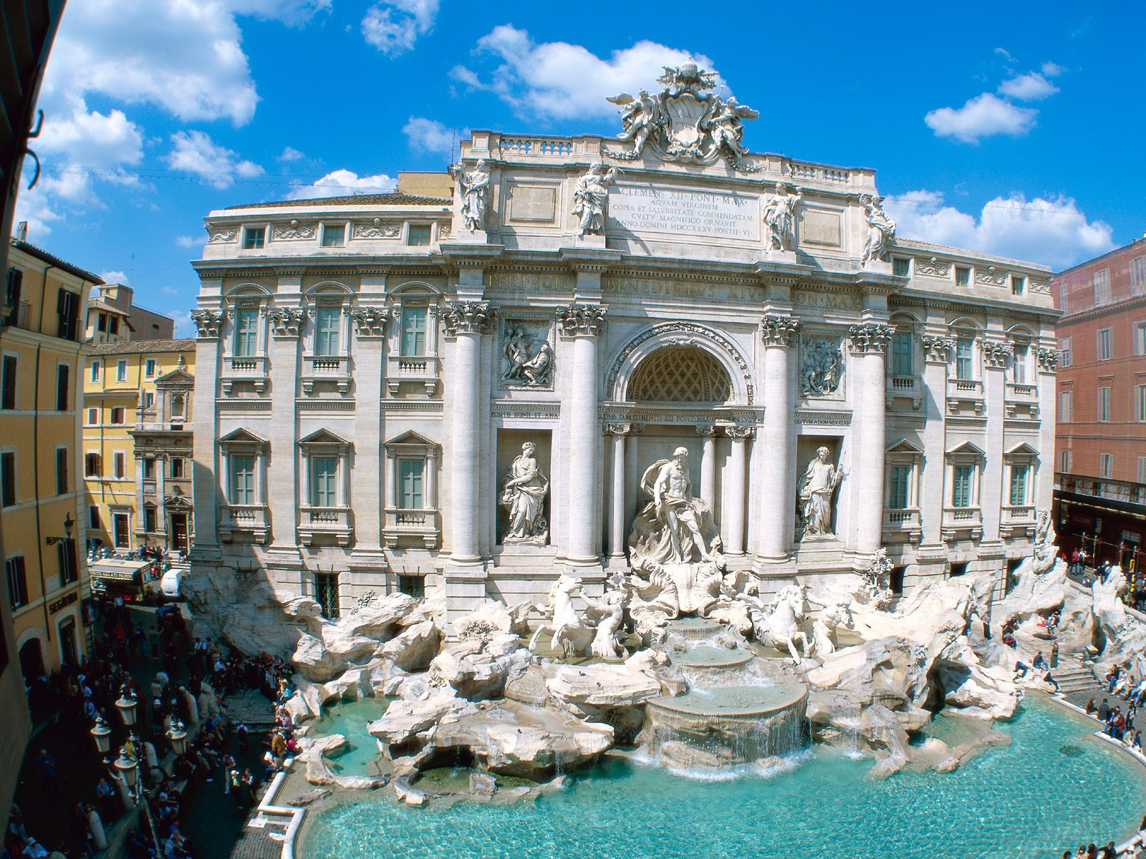
Tentative itinerary
Week 1 – Arrival and Orientation to Rome
-
Colosseum and Ancient Roman Forum
Vatican City
Highlights of Rome
Trevi Fountain
Piazza Navona
Campo dei Fiori
Parliament

Slide 7



venice
San Marco Square
Rialto Bridge
Grand Canal
Venetian Art and Architecture

Slide 8

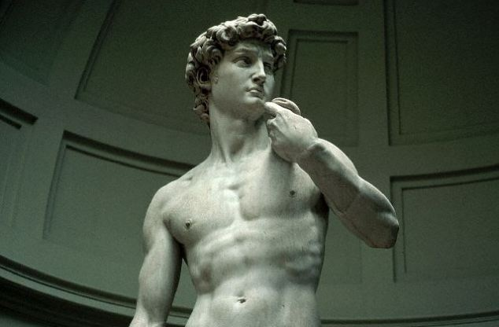
florence
Duomo
Renaissance Art and Architecture
The Medici Family & City States

Slide 9

Service project
To be determined:
Caritas Soup Kitchen
Refugee Center

Slide 10
Program fee
$4925
Includes:
  International Flight
  Housing
  AUR facilities (garden, classroom, computer lab)
  Welcome dinner
  On-site Transportation
  Hotel, train and tours in Florence and Venice
  Rome Tours
  Health Insurance
Does not Include
  GSU Tuition
  Meals ($20/day)
  Personal Expenses
Deadlines
  Application: November 15
  Scholarship: December 1
  First deposit: December 15 ($985)
  Other deposits: January 15, February 15, March 15, April 15 ($985 each)

Slide 11
Financial aid and scholarships
Check with financial aid to see if you are eligible for aid during the summer or if you would like to take out a loan.
Study Abroad Scholarship – Deadline is December 1, 2016
  Application Form
  500 Word Essay + Follow-On Project
  Resume
  2 Letters of Recommendation (Academic or Professional)
  $500-750

Slide 12
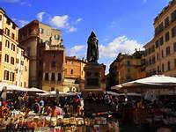

Application process
Make appointment with Study Abroad Coordinator
  Amy Schoenberg aschoenberg@govst.edu
Meet with Financial Aid Advisor
  Matt Zarris mzarris@govst.edu
Fill out application form by November 15
Apply for Study Abroad Scholarship by December 1
Make first deposit of $985 by December 15

