Slide 1

The IRB Process at GovState
Anna Bernadska, PhD
Assistant Director of Research Compliance

Slide 2
Introduction to the GovState IRB
Institutional Review Board (IRB) – an independent committee that reviews research studies to ensure that they comply with the federal regulations protecting human subjects in research.
  GovState IRB has 12 members
  Has monthly meetings during the academic year
  Reviews minimal risk studies on a rolling basis throughout the year

Slide 3
Regulatory Framework
    Belmont Report
        Respect for persons
        Beneficence
        Justice
    Federal regulations: 45 CFR 46, 21 CFR 16, 50, 56
    State policies (e.g., IDHS)
    University policies (e.g., Policy 53)
Notes:
Respect for persons reflects the notion that every individual has the absolute right to decide whether or not to participate in research. The practical application of this principle is the process of informed consent
Beneficence is a concept in research ethics that states that the welfare of the research participant should be given primary importance in any clinical trial or other research study. Consider Risks vs benefits
Justice is about equal distribution of burdens and benefits of a research study. Unless there is a legal or scientific justification for exclusion, all eligible participants should be given an equal chance to participate in the research. This also applies to protected populations, e.g. pregnant women

Slide 4
What Projects Does the IRB Review?
Projects that meet the federal definition of HUMAN SUBJECTS RESEARCH (HSR)
What is HSR?

Slide 5


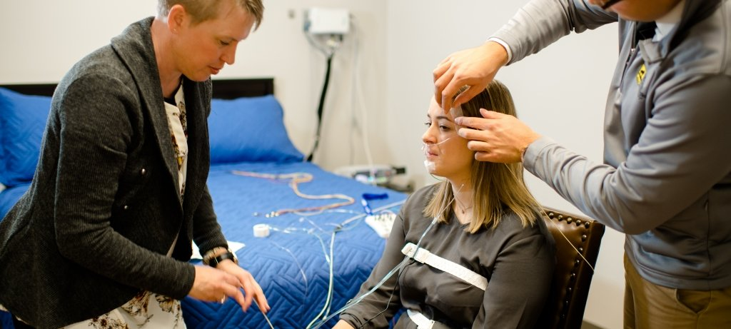
Definition of research
Definition of human subjects
Human Subjects Research
+
=
A systematic investigation… designed to develop or contribute to generalized knowledge
Living individual about whom an investigator conducts research, obtains information, or obtains/uses/generates identifiable private information
Systematic investigation that involves human participants or data about human participants and is designed to contribute to generalizable knowledge

Slide 6
Important
Only the IRB can decide whether a project is HSR
All HSR studies must be submitted for IRB review prior to their implementation. IRB does not grant retroactive approvals.
Human subjects research conducted without IRB approval is not compliant with the federal regulations and institutional policies.

Slide 8
Preparing an IRB Application
What should be done before you start an application
  Complete CITI training in human subjects research
  https://citiprogram.org/
  Required training is Basic Course in Social Behavioral or Biomedical Research
  NOTE: Responsible Conduct of Research course is not accepted by IRB
  See Instructions for CITI training at www.govst.edu/irb

Slide 9
Preparing an IRB Application
What should be done before you start an application
  Design your study:
  Ethical research requires that the study is designed to maximize benefits and minimize risks to subjects
  Consider all potential risks: physical harm, discomfort, emotional distress, burden, privacy and confidentiality, employability, reputation, financial loss

Slide 10
Preparing an IRB Application
What should be done before you start an application
  Clarify the study procedures:
    How participants will be identified? Do you have direct access to participants, or do you need an intermediary?
    How will you know that the participants meet your eligibility requirements?
    How the participants will be recruited? What type of consent will be used?
    How the data will be collected? Where the data will be stored and how it will be protected?

Slide 11
Preparing an IRB Application
What should be done before you start an application
  Create a recruitment document (flyer, email invitation, verbal script, social media ad, etc.)
  Create a consent document using the template that has been approved by the Institutional Review Board (IRB).
  Develop a research instrument
  Obtain letters of support, if needed
  Think about whether any compensation will be offered and how it will be delivered to participants

Slide 12
Submitting an IRB application
  Review Instructions for Submitting an IRB application:
      IRB website:
      www.govst.edu/irb
  Create an application in Cayuse IRB:
      Cayuse IRB
      https://govst.cayuse424.com/rs/irb

Slide 13

Submitting an IRB application
Answer all questions
Attach all required documents
Check the application for clarity and consistency
Confirm the submission

Slide 14

Responding to IRB comments
Ask for clarification if needed
Some comments require action, some are FYI
Make revisions when required, acknowledge FYI comments
If one section is revised, others may need to be revised as well
Revised documents should have REVISED in the title and include a version number and date

Slide 15
