Slide 1

GSU BROWN BAG SESSION
Online Accessibility for Governors State University:
ADA and Section 508 Compliancy

Slide 2
What is “accessibility” and how it matters
"Accessibility" describes the degree to which a product, device, service, or facility is usable by people with all abilities and disabilities.
More specifically, web accessibility means that people with disabilities can perceive, understand, navigate, and interact with the Web.
According to the U.S. Census Bureau, 61 million Americans have disabilities
Approximately 30% of US households have a member with a disability

Slide 3
What is “accessibility” and who it serves
A parent who is blind can pay for school fees on the web site.
A student who is color blind can look at homework at home.
A deaf student can view videos of her online classes.
A physically disabled student who takes classes online who manipulates a webpage not by a mouse or keyboard but by other means

Slide 4
Types of disabilities
Visual Disabilities
• No vision
• Low vision
• Little or no color perception
Auditory Disabilities
No hearing
Limited hearing
Users with assisted listening devices, such as hearing aids
Speech Disabilities
• No speech
• Stuttering
Cognitive and Neurological Disabilities
• Limited cognitive, memory, language, & learning skiIls
• Susceptibility to seizures
Physical Disabilities
• Limited reach and strength
• Use of a prosthetic device
• Limited manual dexterity
Combinations of Disabilities

Slide 5
Why online accessibility matters to GSU
The American Disabilities Act is a civil rights law that encompasses the broader reach of society to protect individuals with disabilities against discrimination in all areas of “public accommodation” in regards to commerce.
Section 508 is a federal law that requires information and communication technology (ICT) developed, procured, maintained or used by federal agencies to be accessible to people with disabilities.

Slide 6
Why online accessibility matters to GSU
The American Disabilities Act is a civil rights law that encompasses the broader reach of society to protect individuals with disabilities against discrimination in all areas of “public accommodation” in regards to commerce.
Section 508 is a federal law that requires information and communication technology (ICT) developed, procured, maintained or used by federal agencies to be accessible to people with disabilities.
Governors State University is considered a state agency and is both state and federal funded.
GSU must abide to practices that every state agency abides including accessibility requirements to receive federal/state funding. A yearly audit occurs from agencies hired by the state that investigates whether we adhere to these compliances or are in violation.
If found in violation, GSU will lose funding and may even be fined for every day they are in violation of the ADA/Section 508 compliance requirements.

Slide 7
Why online accessibility matters to GSU
It’s not only to government agencies that a university’s ADA compliancy are accountable to, but also with civil lawsuits from disability rights activists for being being non-compliant.
There have been thousands of documented lawsuits against higher education institutions where their online communication has failed to meet accessibility issues. Some have resulted in millions of dollars of compensatory awards.
If someone with a disability has an issue with a university’s online communication it becomes a civil right violation.

Slide 8
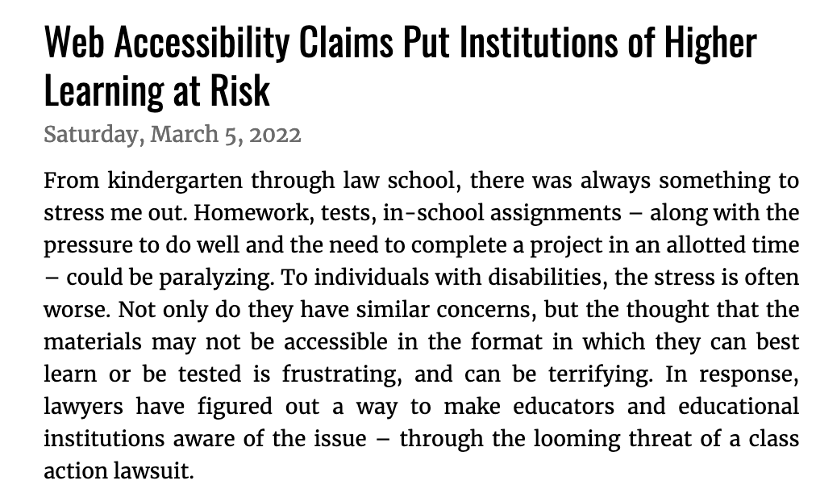
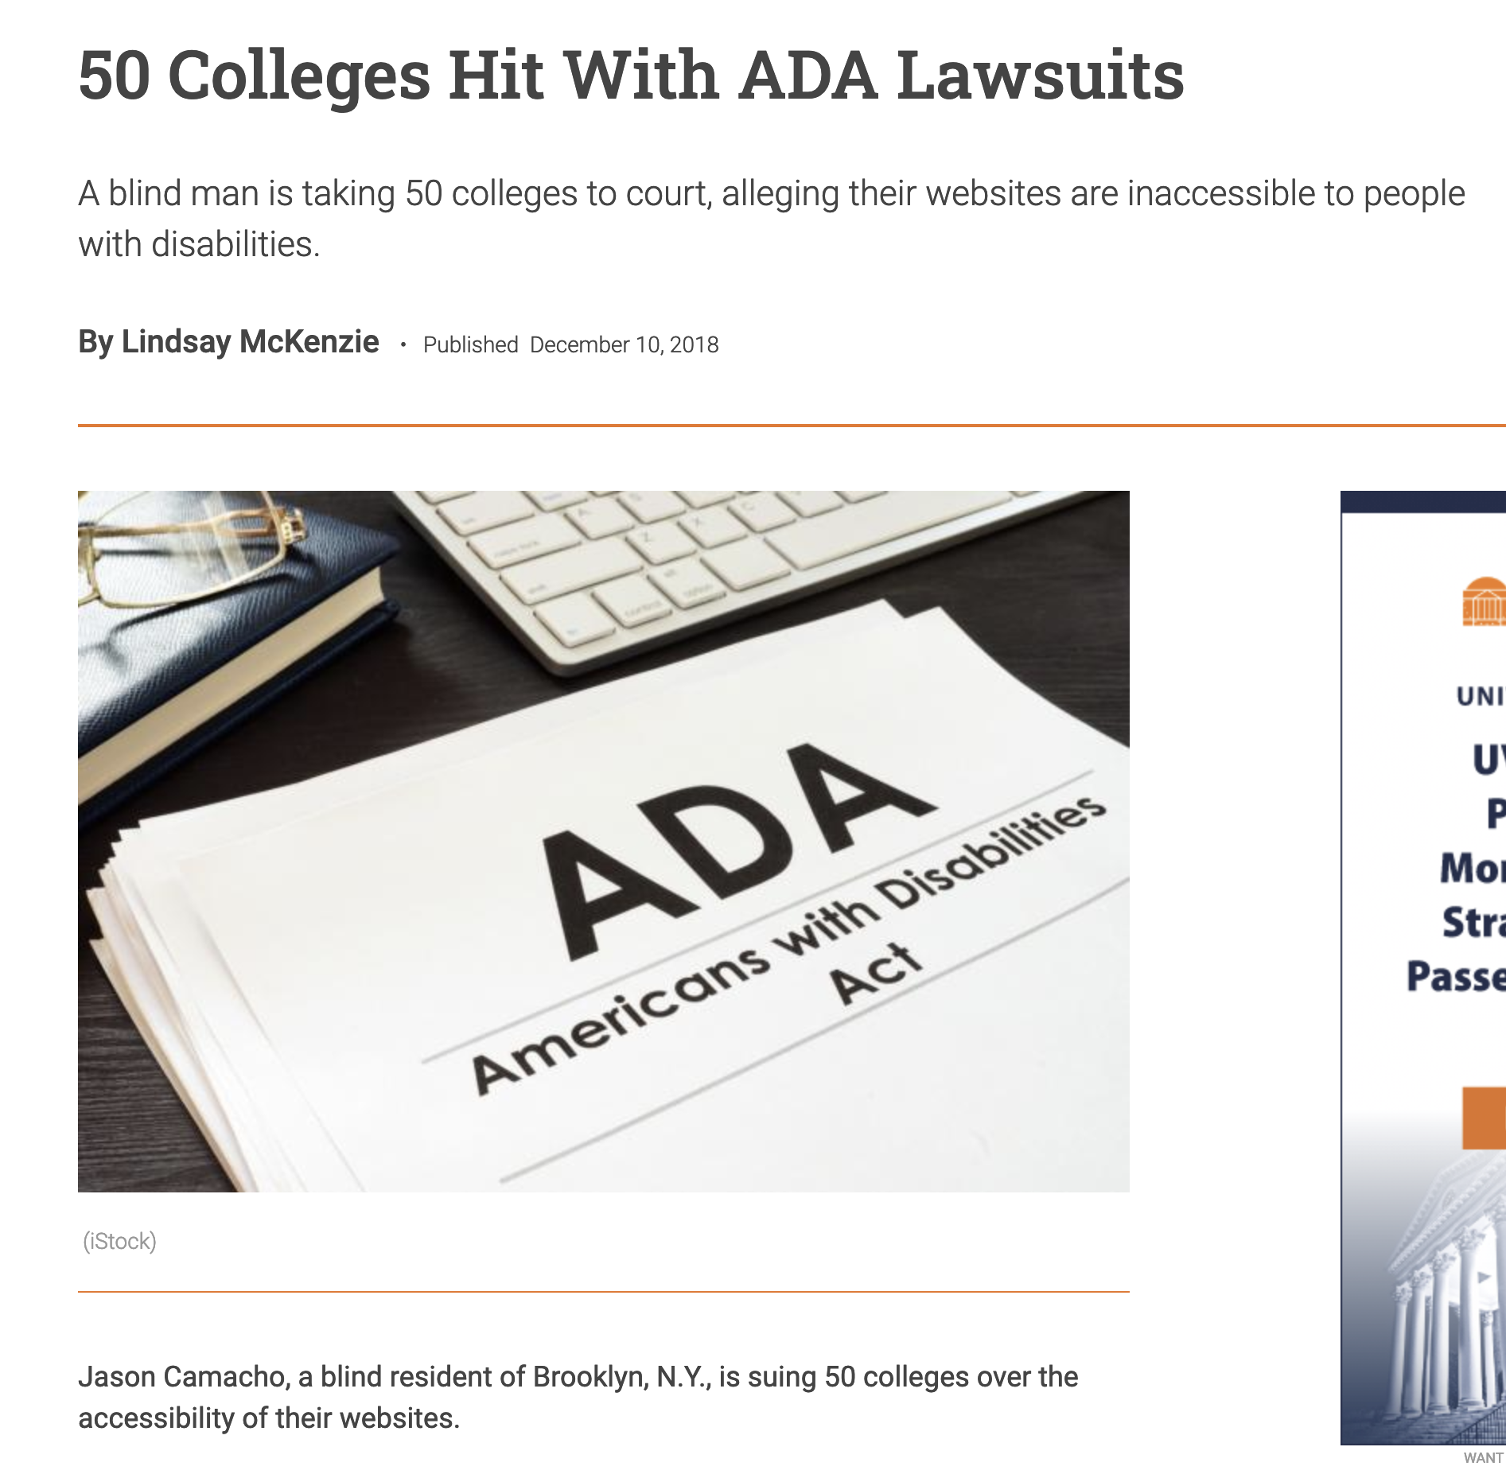
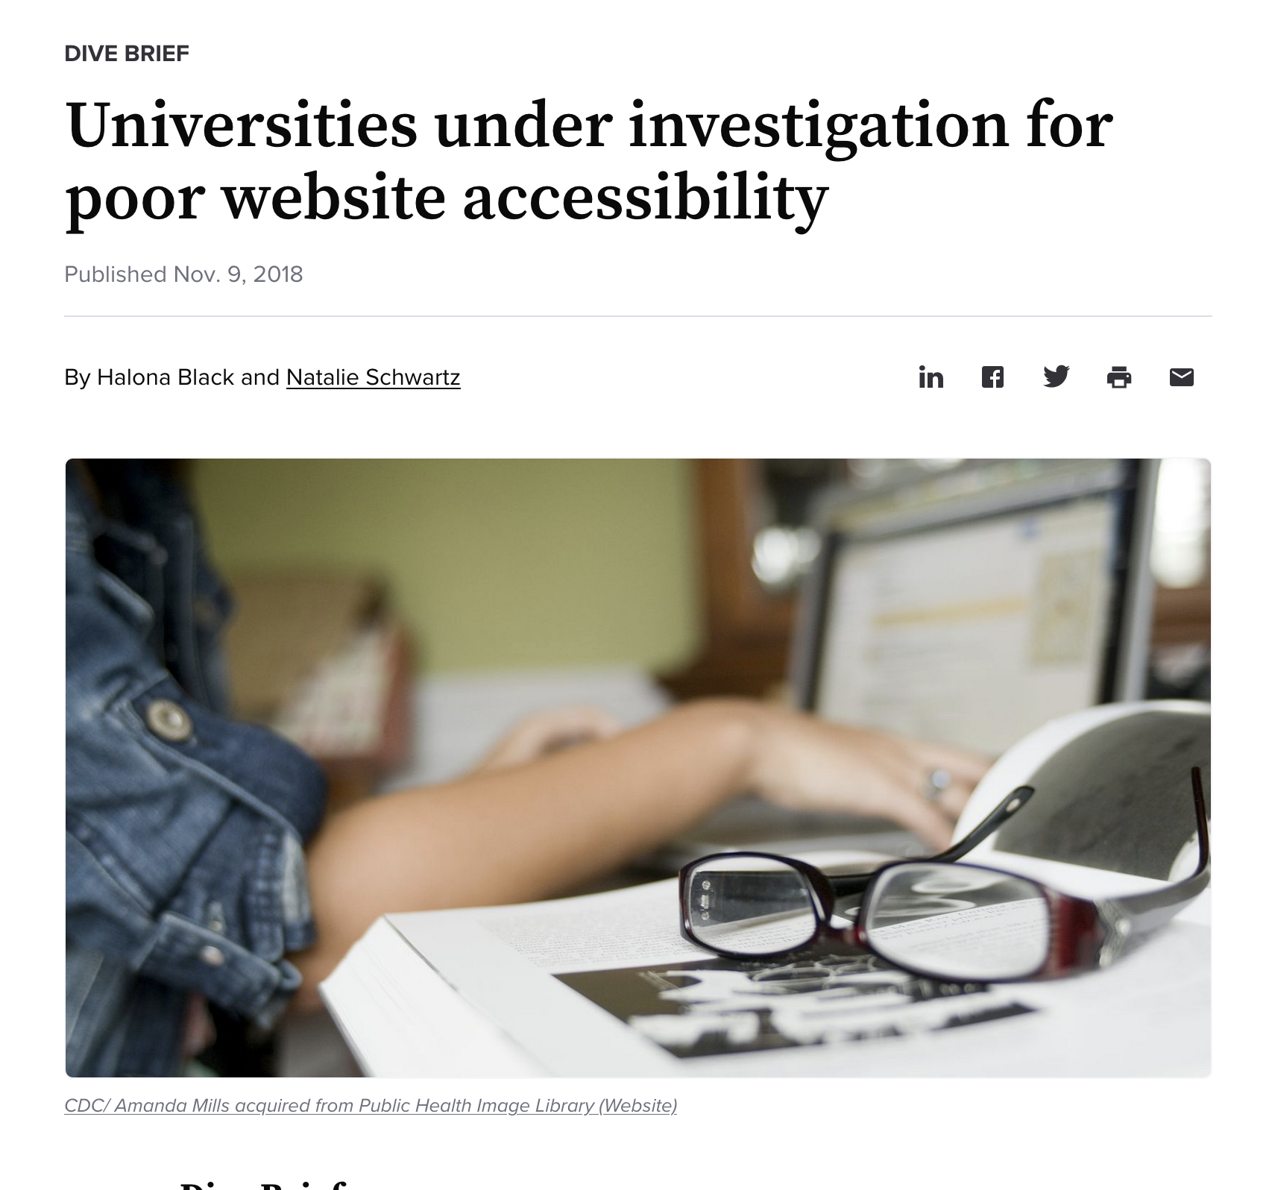
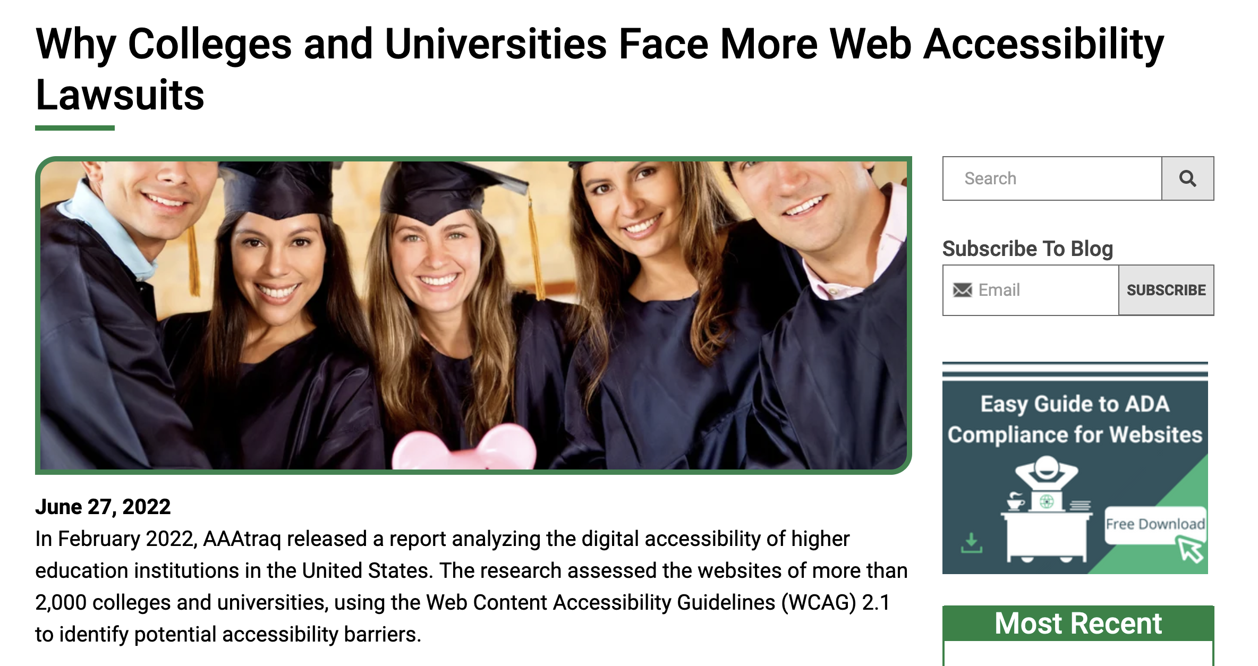
Why online accessibility matters to GSU
If someone with a disability has an issue with a university’s online communication it becomes a civil right violation.

Slide 9
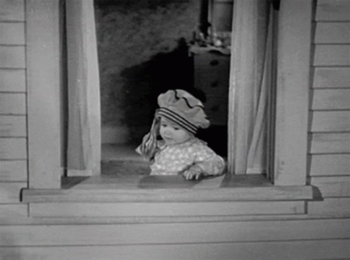
Why online accessibility matters to GSU
Being non ADA and Section 508 compliant results in the university losing tens of thousands if not millions of dollars in federal and state funding and grants as well as compensatory awards from civil lawsuits.
Which is why the Marketing & Communication department wants to protect our university from such loss by asking everyone to adhere to ADA and Section 508 compliance.

Slide 10
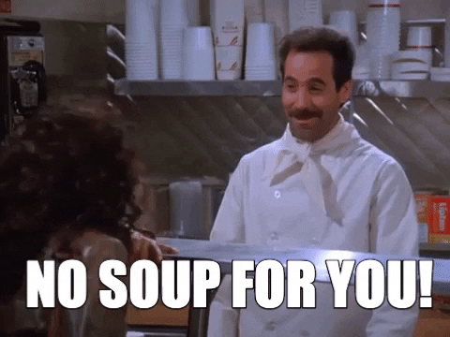
Why online accessibility matters to GSU
…and not some arbitrary reason to deny the University staff and faculty from communicating with the university’s community.

Slide 11
How can GSU become accessible online?
There are simple and non-remarkable ways for our university to be ADA and Section 508 compliant online
Use High-Contrast Colors
Provide Alt Text for Images
Ensure Your Site Allows Keyboard Navigation
Use Heading Hierarchies to Structure and Organize Content
Website
E-blasts
PDFs
Social Media

Slide 12
How can GSU become accessible online?
Use High-Contrast Colors
Some users may have difficulty seeing text if the color contrast is low. Therefore, we recommend using colors that have a high contrast ratio, such as black and white or black and yellow.
The color contrast throughout your messaging should ensure that all elements are distinguishable on the page. For instance, text should stand out rather than blending into the background.

Slide 13
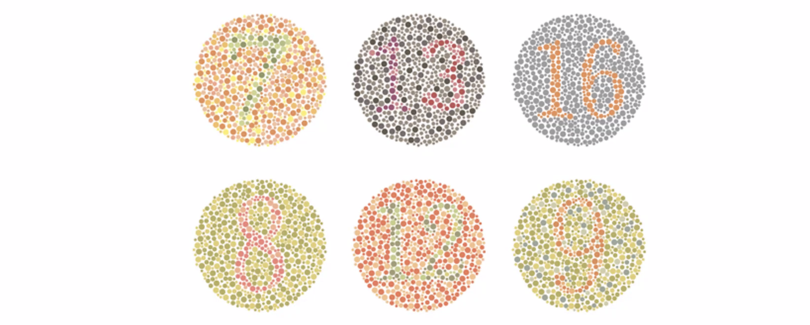
How can GSU become accessible online?
Examples of Low Contrast Colors

Slide 14
How can GSU become accessible online?
Use High-Contrast Colors
Which is why we are phasing out the use of the orange color fonts and the orange color background with white fonts.
ORANGE FONTS
WHITE FONTS W/ ORANGE BG

Slide 15
How can GSU become accessible online?
Use High-Contrast Colors
We are implementing the use of the dark color fonts and the dark color background with white fonts.
DARK FONTS
WHITE FONTS W/ DARK BG

Slide 16
How can GSU become accessible online?
Provide ALT-TEXT for Images
If you use images on your website, be sure to provide alternative text (alt text) that describes the image. This way, users who are unable to see the image will still be able to understand the content of the page when using assistive technologies such as dictation software.

Slide 17
How can GSU become accessible online?
Provide ALT-TEXT for Images
Users with visual disabilities may use a SCREEN READER to read the content of any online material they wish to listen to.
A screen reader reads the text on a page and when they encounter an image it registers as a “blank” if there is no ALTERNATIVE TEXT to provide descriptions of the image.

Slide 18
How can GSU become accessible online?
Provide ALT-TEXT for Images
Whether using a web system to update your site, an email system to create an eblast with an image, a PDF you are hosting online or a social media post always provide a DESCRIPTION OF THE IMAGE USED AS ALT-TEXT.
There should be little to no text in the image. Images with headlines and content are NOT ADA/Section 508 compliant. If it has an image with minimal text provide a description of the image with the actual text that’s on the image. But it’s best to have no text on images at all.
Your text should be in the content area of your online document .

Slide 19

How can GSU become accessible online?
ALT-TEXT for Images

Slide 20
How can GSU become accessible online?
ALT-TEXT for Images
An ALT-TEXT descriptor would be:
“GSU students sitting outdoors at the sculpture park”
Keep it simple
Keep it literal
Keep it short

Slide 21
How can GSU become accessible online?
Provide ALT-TEXT for Images
There are a number of ways to provide text in online communication:
In websites, CMS systems should provide you with a form to add descriptive ALT-TEXT to images
In composing e-mails, you can right click on an image and a menu appears with the ability to add ALT-TEXT ( contact the Marketing department for training on how to do so)
In social media, most platforms already provide a descriptive ALT-TEXT for you
In PDFs, it’s best if ALT-TEXT is provided in Microsoft Word or in software used to create the document before converting it to a PDF

Slide 22
How can GSU become accessible online?
Provide ALT-TEXT for Images
Here are some references on how provide ALT-TEXT in Outlook and Microsoft Word:
Add ALT-TEXT in Outlook
https://support.microsoft.com/en-us/office/add-alternative-text-to-a-shape-picture-chart-smartart-graphic-or-other-object-44989b2a-903c-4d9a-b742-6a75b451c669#PickTab=Windows
Provide ALT-TEXT in documents for PDFs
https://accessible-pdf.info/basics/general/add-an-alt-text

Slide 23
How can GSU become accessible online?
Ensure Your Site Allows Keyboard Navigation
Use Heading Hierarchies to Structure and Organize Content

Slide 25
GSU BROWN BAG SESSION
Tony De Castro
adecastro@govst.edu

