Slide 1
Navigating Public Service Loan Forgiveness (PSLF)
Office of Financial Aid

Slide 2
First Things First (Disclaimer)
The PSLF information presented is accurate as of today, based on currently available information. The PSLF Program or the conditions of the PSLF Program can or may change.
The borrower is responsible (you) for keeping up to date on the news, any changes in the PSLF Program, and for filing all required documentation and forms for the program.
The borrower is also responsible for selecting their Repayment Plan, Consolidation decision, and all aspects of loan repayment that best meet their needs and specific plans. If unsure, ask us or contact Mohela Servicing or your loan Servicer, before you make a change or decision, as needed.
www.Mohela.com OR 855.265.4038
Fun Tip…PSLF was enacted, in October 2007, as part of the College Cost Reduction and Access Act (CCRAA).

Slide 3
What is Public Service Loan Forgiveness anyway?
Public Service Loan Forgiveness is a federal program that forgives the remaining balance on your Direct Loans after you have made 120 qualifying monthly payments (10-years)under a qualifying repayment plan while working full-time for a qualifying* employer. You are NOT taxed on the forgiven amount.
*U.S. Federal, state, local, or tribal government entity or not-for-profit, and U.S. Military

Slide 4
Eligibility Requirements: #1
#1-ELIGIBLE LOANS
Make sure all your loans are eligible!
DIRECT Subsidized & Unsubsidized Loans
DIRECT Grad/PLUS & Parent PLUS Loans
DIRECT Federal Consolidation Loans
*NON-Eligible Loans: (Federal Family Education Loan) FFEL Stafford, FFEL Grad PLUS, FFEL Federal Consolidation, Perkins, also DHHS loans: LDS and PCL
*You may make some Non-Eligible Loans, eligible for PSLF, by consolidating them into a DIRECT Federal Consolidation Loan (FFEL loans, Perkins & LDS)
Note: Defaulted Loans, Private Loans, PCL loans & Consolidation Loans that contain a spousal Consolidation Loan are not eligible

Slide 5
Eligibility Requirements: #2
#2-QUALIFYING PAYMENTS
Make sure you select a qualifying repayment plan!
Income-Driven Repayment Plans:
Pay As You Earn (PAYE)
Revised Pay As You Earn (REPAYE)
Income-Based Repayment (IBR)
Income-Contingent Repayment (ICR)
While simultaneously working in a qualifying public service position, you must make 120 full, on-time & scheduled payments (Cannot be late), under a qualifying repayment plan
Payments made when not required = Do not qualify, you can’t ‘speed’ up the process. Payments made during in-school status, grace period, deferment, or forbearance don’t count towards the 120.
Note: Payments do not have to be consecutive, allowing for changes in employers & periods of non-work.
Voluntary payments do not count towards PSLF.

Slide 6
Eligibility Requirements: #3
#3-QUALIFYING WORK
Make sure your employer is a qualifying employer!
You must be employed full-time* for a total of 10 years (120 payments) in a public service position
Nonprofit tax-exempt 501( c) (3) organization-
(includes many medical schools & residency programs)
Federal, State, Local, or Tribal government organization, agency or entity
A branch of the military
Public service organization-a private organization providing a public service
Questions about eligible employers-contact Mohela Servicing at Mohela.com
Note: Full-time* work is 30 hours per week or the number of hours the employer considers to be full-time

Slide 7
All Three = Loan Forgiveness
Eligible Loans
DIRECT Federal Loans
Qualifying Payments
PAYE, REPAYE, IBR or ICR
Qualifying Work
Public Service

Slide 8
What about the TEPSLF?
The temporary/limited PSLF waiver refers to the time-limited changes to Public Service Loan Forgiveness (PSLF) Program rules that allow borrowers to receive credit for past periods of repayment that would otherwise not qualify for PSLF. This opportunity ends on Oct. 31, 2022.
The waiver will give you automatic credit towards the 120 payments only if the employer listed on your form was determined to be a qualifying employer, but you originally did not receive credit because you (1) didn’t have the right kind of loan, (2) weren’t in the right repayment plan, (3) made the payment late, or (4) did not pay the full amount due.
If you consolidate due to FFEL/Perkins, etc., your previous payments will be accounted for on your new consolidation loan as long as those previous payments were made after October 1, 2007. The TEPSLF only counts payments made after October 1, 2007.
What about parent plus loans? Yes and no!
If you took out a parent plus loan AND also have your own loans, you must consolidate into a new direct consolidated loan. Then that loan will be considered. IF you only took out a parent plus loan for your child, then NO it is not eligible.

Slide 9
Jax The Jaguar- Modeling PSLF
Single with no dependents
Has an AGI of $35,000 that rises at 5% a year
Has $50,000 in Direct Loan Debt ($23,000 subsidized loan debt), all of which has a 6% interest rate
Borrowed for graduate school

Slide 10
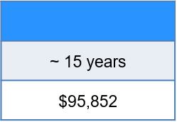
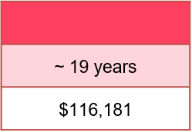
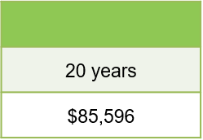
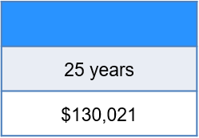
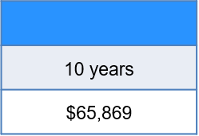
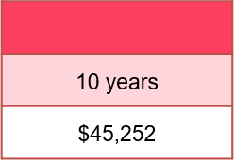
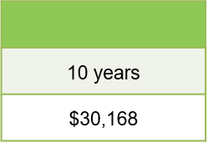
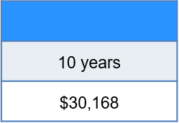
Overall Paid
PAYE
Without PSLF
ICR
IBR
PAYE
REPAYE
IBR
REPAYE
Time in Repayment
Total Paid
ICR
Total Forgiven
$0
$0
$49,021
$7,834
With PSLF
ICR
IBR
PAYE
REPAYE
Time in Repayment
Total Paid
Total Forgiven
$26,789
$54,922
$71,357
$67,523

Slide 11
PSLF Tool
https://studentaid.gov/pslf/
This will allow you to evaluate your eligibility for forgiveness. It will inform you if your workplace is eligible, and you’ll receive a count of the number of qualifying payments you’ve made towards PSLF.

Slide 12
How Do I Get Started?
Fill out the PSLF Form by using the PSLF Tool which will pre-fill a portion of the form using the information that you submit. This will also provide you with additional information concerning PSLF.
The tool will then tell you if your employer counts towards PSLF and if your payments count as qualifying thus far.

Slide 13
FAQ’s
Retroactive Payments:
When you’ve made your 115th payment you’re offered an option to make the last five payments in one and have it forgiven sooner.
COVID Forbearance: Does that count towards the 120 payments?
Yes, as long as you work for a qualifying employer (full-time) and continued to make your monthly pre-covid payment.
PSLF Temporary Waiver
This waiver was brought about three years ago if you made a payment, and it didn’t qualify for PSLF. They can adjust and make that payment count.
How long do I have to wait to hear back after submitting?
Due to the increased number of applications, they’re giving a turnaround time of 3 months.

Slide 14
Cares Act-Administrative Forbearance
March 20, 2020: suspension of federal loan payments, stopped collections on defaulted loans, and a 0% interest rate.
March 27, 2020: CARES Act became law, providing for the above relief measures through Sept. 30, 2020.
April 6, 2022: relief measures extended again through Aug.21, 2022
August 2022: FINAL Student loan pause until January 2023.

